Slide 1

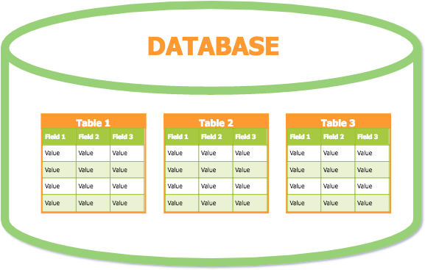
Databases
Lesson 6 SQL Constraints
1

Slide 2
SQL Constraints
Used to specify rules for the data in a table.
Used to limit or validate the type of data that is entered to a table.
Ensures the accuracy and reliability of the data in the table.
Constraints can be specified when:
creating a table (inside the CREATE TABLE statement) or
after creating a table (inside the ALTER TABLE statement)

Slide 3
SQL Constraints
NOT NULL
Indicate that a field cannot store NULL values.
UNIQUE
Ensure that each record for a field must have a unique value.
DEFAULT
Add a default value to all new records when no specific value
is entered to that field.
CHECK
Ensure that the value in a field meets a specific condition.
Used to limit the value range that can be placed in a column.

Slide 4
SQL Constraints
PRIMARY KEY
A combination of a NOT NULL and UNIQUE.
Ensures that a field (or combination fields) has an unique identity which helps to find a particular record in a table more easily and quickly.
FOREIGN KEY
Ensure the referential integrity of data in one table to match values in another table.

Slide 5
NULL Value Concept
When a variable has no value, it considered to be null.
Having a null value is different than having a value of 0.
Setting a Null value is appropriate when the actual value is unknown or when a value is meaningless.
When a column is defined as NOT NULL then that is a mandatory column. User is forced to enter data into that column.

Slide 6
SQL Constraints
CREATE TABLE Persons (
PersonID int PRIMARY KEY, LastName varchar(25) NOT NULL, FirstName varchar(15),
Address varchar(255), NIC varchar(10) UNIQUE, City varchar(25)
)

Slide 7
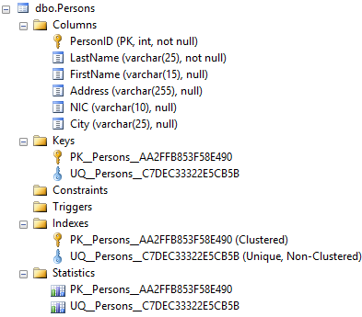

Slide 8
CREATE TABLE Persons (
PersonID int,
LastName varchar(25) NOT NULL , FirstName varchar(15),
Address varchar(255), NIC varchar(10),
City varchar(25) PRIMARY KEY (PersonID), UNIQUE (NIC)
)

Slide 9
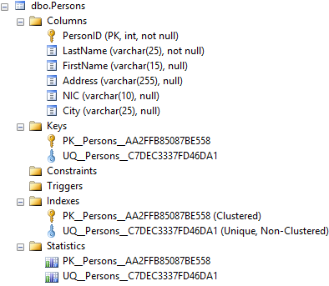

Slide 10
Alter Constraints - NOT NULL
ALTER TABLE Persons
ALTER COLUMN LastName NOT NULL
To remove NOT NULL constraint:
ALTER TABLE Persons
ALTER COLUMN LastName NULL

Slide 11
Alter Constraints - PK
ALTER TABLE Persons
ADD PRIMARY KEY (PersonID)
ALTER TABLE Persons
DROP PK Persons AA2FFB85E4ADBBA2
Constraint Name

Slide 12
Giving Constraint Names
CREATE TABLE Persons ( PersonID int,
LastName varchar(25) NOT NULL, FirstName varchar(15),
Address varchar(255), NIC varchar(10),
City varchar(25)
CONSTRAINT pk_PersonID PRIMARY KEY (PersonID),
CONSTRAINT uq_NIC UNIQUE (NIC) )

Slide 13
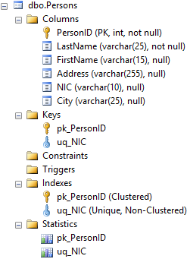

Slide 14
Alter Constraints - Unique
ALTER TABLE Persons ADD UNIQUE (NIC)
ALTER TABLE Persons
ADD CONSTRAINT UC_Person UNIQUE (NIC)
ALTER TABLE Persons
DROP CONSTRAINT UC_Person

Slide 15
Alter Constraints - PK
ALTER TABLE Persons
ADD CONSTRAINT pk_PersonID PRIMARY KEY
(PersonID)
ALTER TABLE Persons
DROP CONSTRAINT pk_PersonID

Slide 16
Composite Primary Key
CREATE TABLE Payment ( PersonID int, PayDate DATE, Amount MONEY,
PRIMARY KEY (PersonID, PayDate)
)

Slide 17
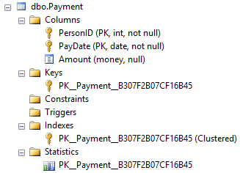

Slide 18
Composite Primary Key
CREATE TABLE Payment ( PersonID int, PayDate DATE, Amount MONEY,
CONSTRAINT pk_Payment PRIMARY KEY
(PersonID , PayDate)
)

Slide 19
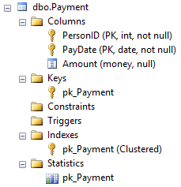

Slide 20
FOREIGN KEY
CREATE TABLE Orders (
OrdID int PRIMARY KEY,
OrdDate date NOT NULL,
PersonID int FOREIGN KEY REFERENCES
Persons (PersonID)
)

Slide 21
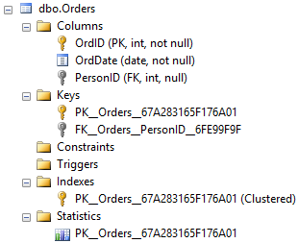

Slide 22
FOREIGN KEY
CREATE TABLE Orders (
OrdID int,
OrdDate date NOT NULL, PersonID int,
CONSTRAINT pk_OrdID PRIMARY KEY (OrdID),
CONSTRAINT fk_PersonID FOREIGN KEY
(PersonID) REFERENCES Persons(PersonID)
)

Slide 23
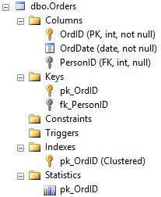

Slide 24
Alter Constraints - FK
ALTER TABLE Orders
ADD FOREIGN KEY (PersonID) REFERENCES Persons
(PersonID)
ALTER TABLE Orders
ADD CONSTRAINT FK_PersonOrder
FOREIGN KEY (PersonID) REFERENCES Persons (PersonID)
ALTER TABLE Orders
DROP CONSTRAINT FK_PersonOrder;

Slide 25
Default Constraint
CREATE TABLE Persons (
PersonID int PRIMARY KEY, LastName varchar(25) NOT NULL, FirstName varchar(15),
Address varchar(255), NIC varchar(10) UNIQUE,
City varchar(20) DEFAULT (‘Colombo’)
)

Slide 26
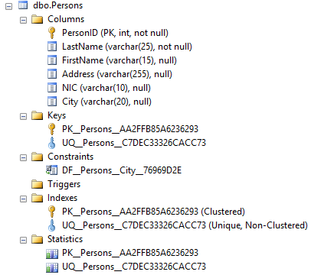

Slide 27
Default Constraint
CREATE TABLE Orders
(
OrderID int NOT NULL, OrderNumber int NOT NULL, OrderDate date DEFAULT GETDATE()
)

Slide 28
Alter Constraints - Default
ALTER TABLE Persons
ALTER COLUMN City SET DEFAULT ‘Colombo’
ALTER TABLE Persons
ALTER COLUMN City DROP DEFAULT

Slide 29
CHECK Constraints
CREATE TABLE Persons (
PersonID int CHECK (PersonID>0) PRIMARY KEY, LastName varchar(25) NOT NULL,
FirstName varchar(15),
Address varchar(255), NIC varchar(10) UNIQUE,
City varchar(20) DEFAULT (‘Colombo’)
)

Slide 30
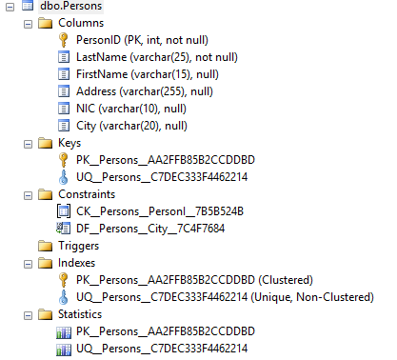

Slide 31
CREATE TABLE Persons ( PersonID int NOT NULL,
LastName varchar(255) NOT NULL, FirstName varchar(255),
Address varchar(255), City varchar(255),
CONSTRAINT pk_PersonID PRIMARY KEY
(PersonID),
CONSTRAINT chk_Person CHECK
(PersonID>0 AND City=‘Colombo'))

Slide 32
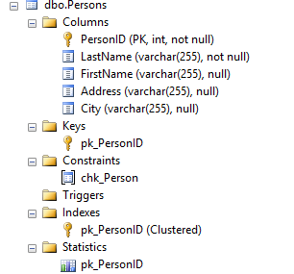

Slide 33
Alter Constraints - Check
ALTER TABLE Persons
ADD COLUMN Age int CHECK (Age>=18)
ALTER TABLE Persons
ADD CONSTRAINT chk_Person CHECK (Age >= 18 AND City = ‘Colombo')
ALTER TABLE Persons
DROP CONSTRAINT chk_Person

Slide 34
Thank You
34

